Slide 1

Midterm Presentation
By: Russell Ballard and Alonso Romero

Slide 2

The Data Set
Kaggle: https://www.kaggle.com/datasets/tysonpo/ice-cream-dataset/data
4 brands:
Ben & Jerry’s, Häagen-Dazs, Talenti, and Breyers
Contains two datasets:
Products: 241 data points
brand, key, name, subhead, description, rating, rating_count, ingredients
Reviews: 21,674 data points
brand, key, author, date, stars, title, helpful_yes, helpful_no, text, ingredients, texture, likes

Slide 3
The Data Set
Important points to note from author of dataset:
“The collection of reviews on the brand websites may not be representative of overall opinion, i.e. there may be review censoring or presence of fake reviews meant to help/harm the image of the brand” (Pond, 2020)
To combat this, the author, “intentionally chose brands that host some negative reviews on their website” (Pond, 2020)
Unilever owns Ben & Jerry’s, Breyers, and Talenti
Froneri owns Häagen-Dazs
“Talenti is distinguished from the other brands as they produce gelato” (Pond, 2020)

Slide 4

Data Analysis Question
Are there differences amongst the different brands in terms of ratings or discernable themes in the product reviews?
Is there independence between icecream ingredient content and review rating?

Slide 5

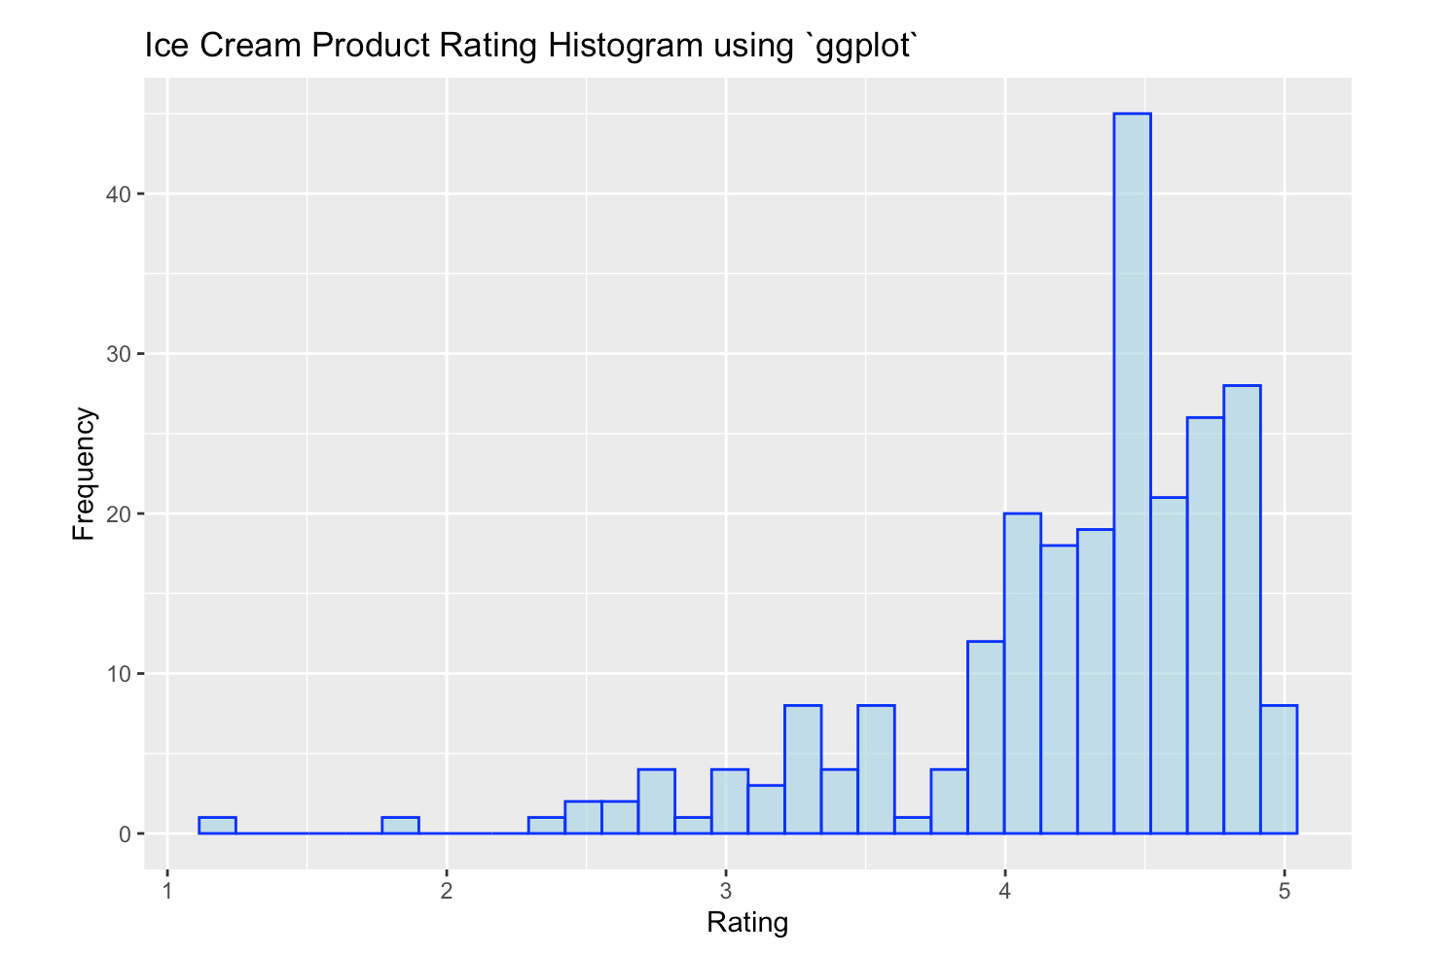
Exploratory Data Analysis: Overall
Mean: 4.223
Median: 4.4
Mode: 4.7
Range: 1.2 - 5
Mean Deviation: 0.46
Standard Deviation: 0.62
Variance: 0.385

Slide 6
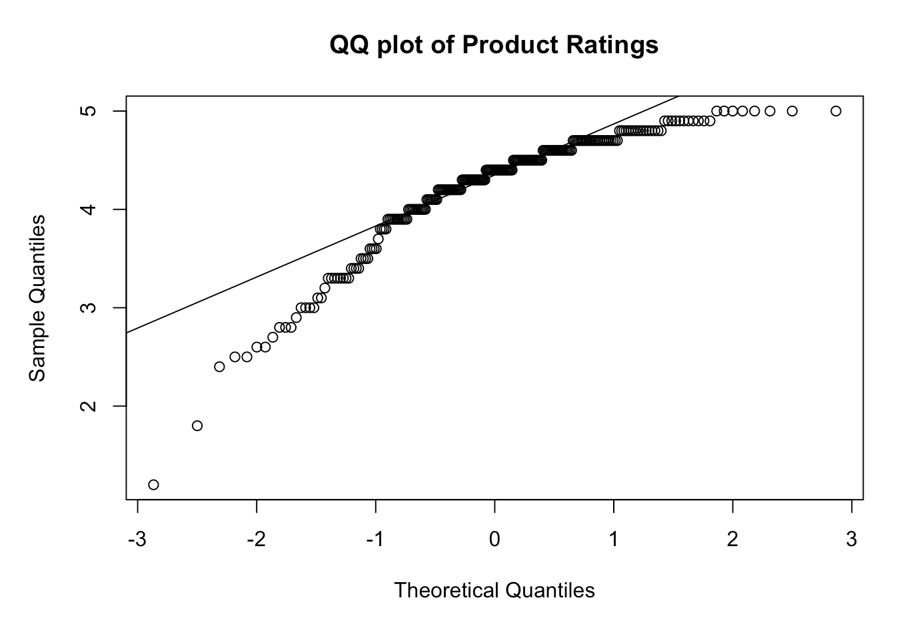
Exploratory Data Analysis: Overall
Left-skewed
Shapiro-Wilk Normality Test
p-value: 0.00000000000009

Slide 7
Exploratory Data Analysis: Individual
 | Ben & Jerry’s | Häagen-Dazs | Talenti | Breyers
Mean | 4.332 | 4.307 | 4.356 | 3.962
Median | 4.6 | 4.5 | 4.4 | 4.2
Mode | 4.7 | 4.6 & 4.8 | 4.7 | 4.4
Range | 1.8 - 5 | 2.5 - 5 | 2.8 - 4.8 | 1.2 - 5
Mean Deviation | 0.443 | 0.446 | 0.28 | 0.544
Standard Deviation | 0.6 | 0.597 | 0.387 | 0.711
Variance | 0.36 | 0.357 | 0.15 | 0.506

Slide 8
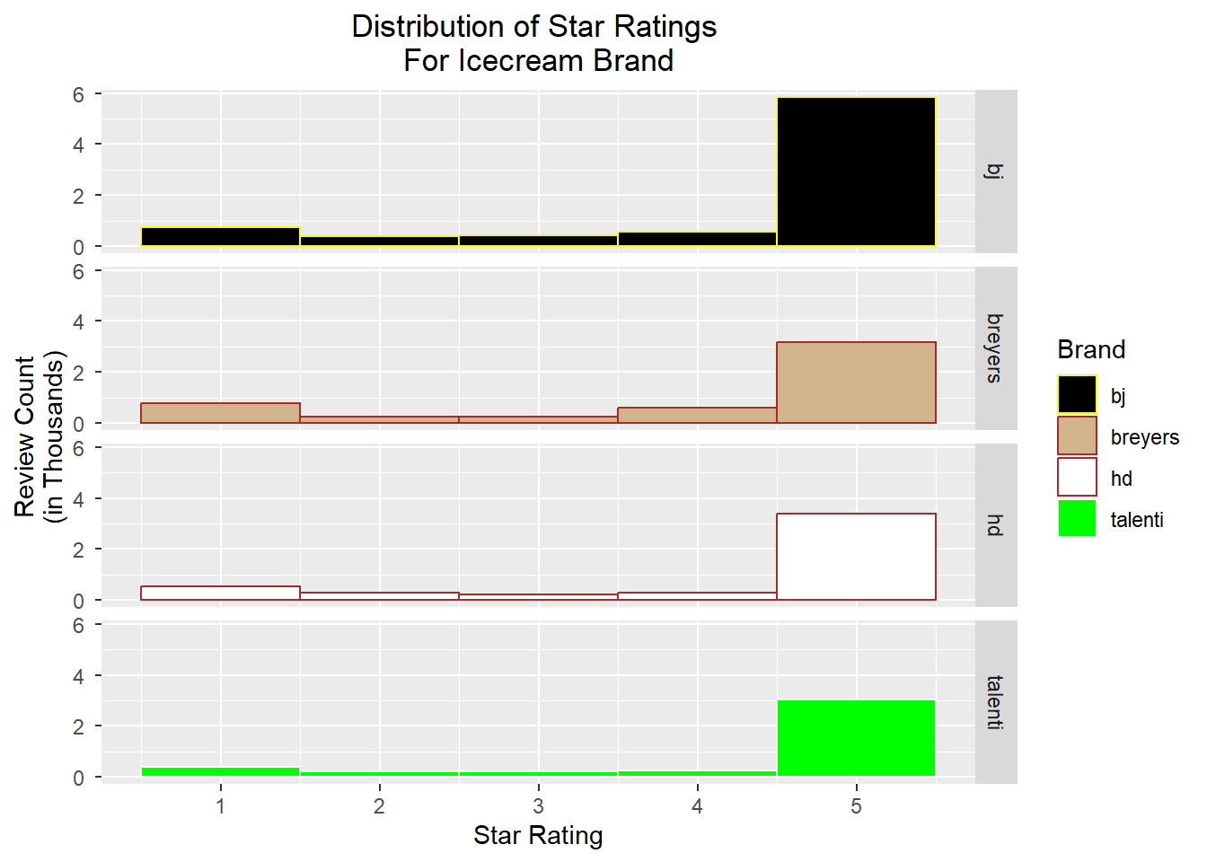
Exploratory Data Analysis
This faceted histogram confirms the annotators note that all the brands have a suspicious preponderance of 5 stars.
Perhaps everyone just likes ice cream…

Slide 9
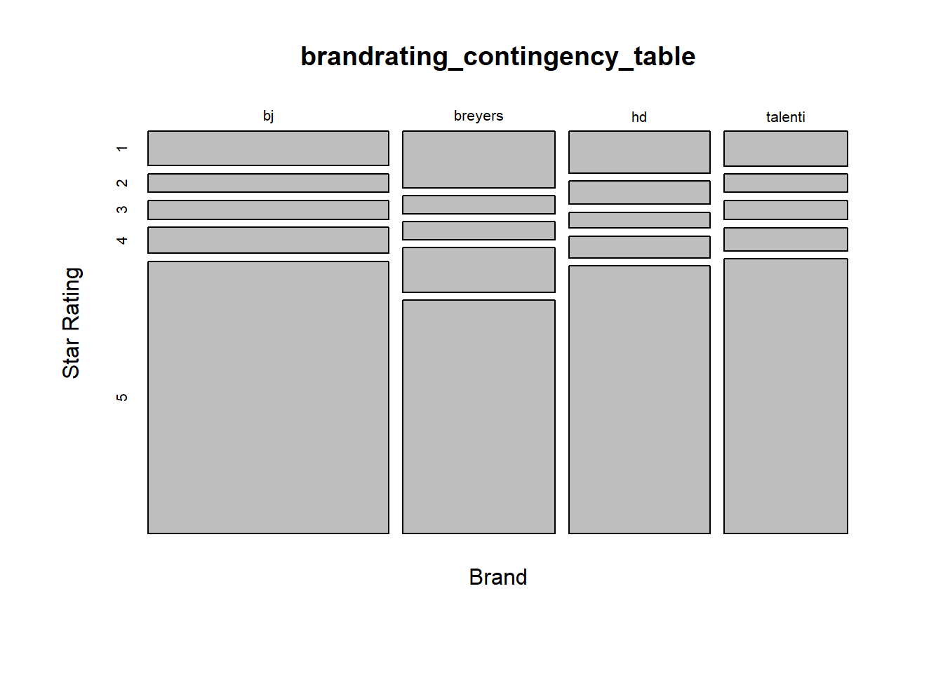
Exploratory Data Analysis
Another view of the brands-ratings. We see that proportionally Breyers has a larger number of non-5 ratings than the others.

Slide 10
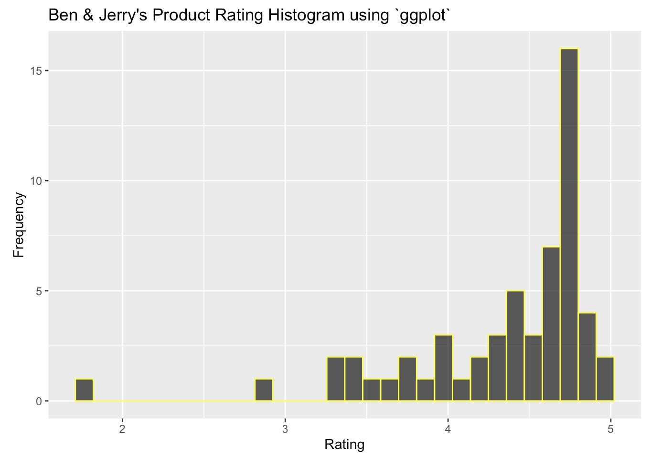
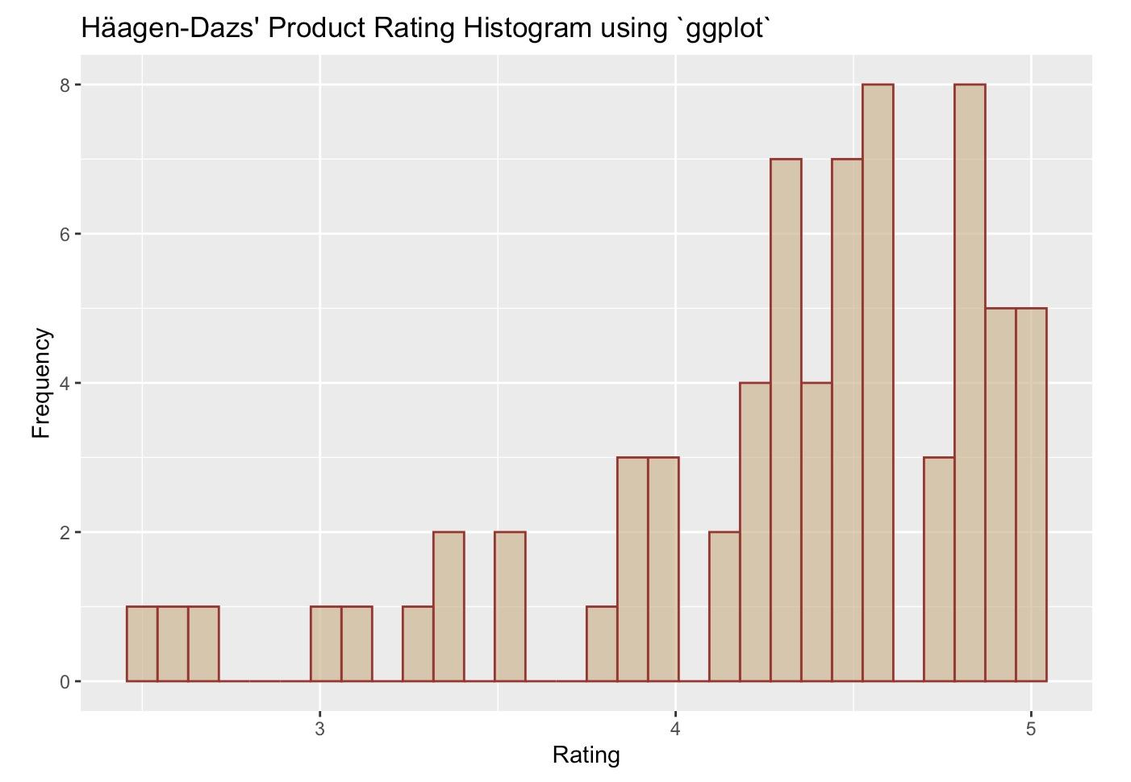
Exploratory Data Analysis: Individual

Slide 11
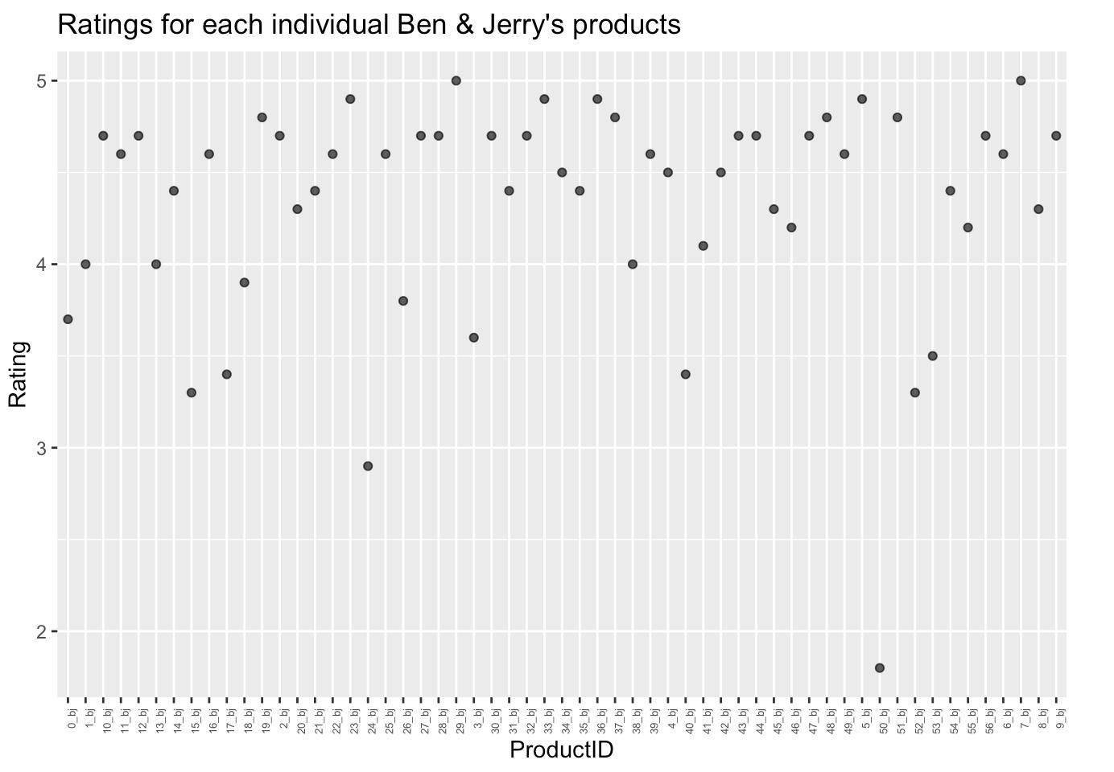
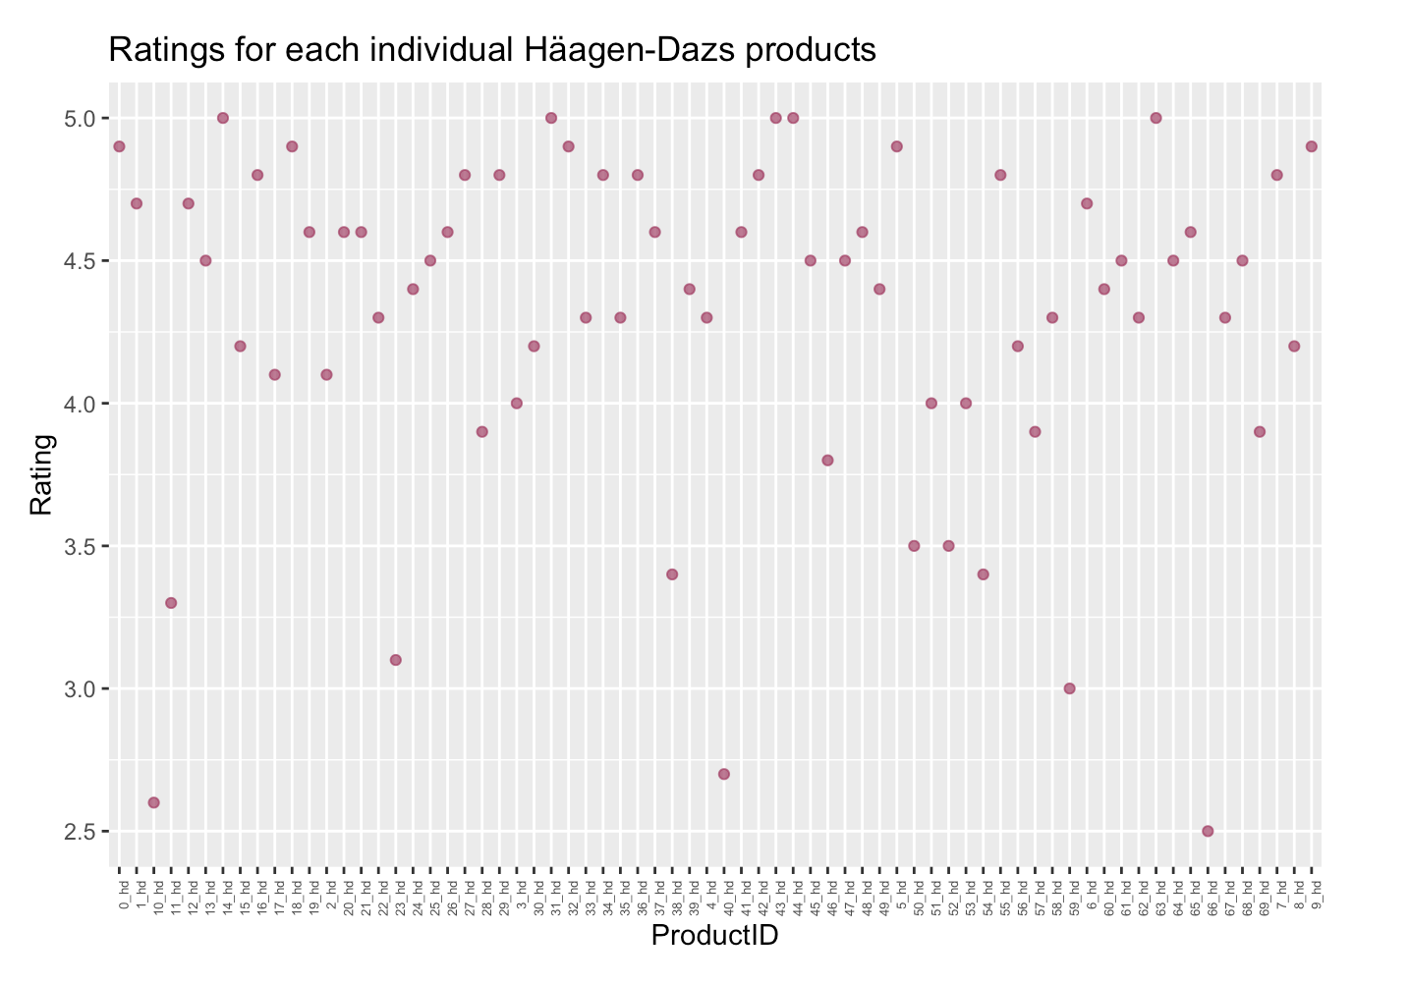
Exploratory Data Analysis: Individual

Slide 12

Exploratory Data Analysis: Top Rated Products
Ben & Jerry’s
Chocolate Peanut Butter Split, Ice Cream Sammie
Häagen-Dazs
Chocolate Fudge Non-Dairy Bar, Honey Salted Caramel Almond Ice Cream, Peppermint Bark Ice Cream, Peppermint Bark Ice Cream Bar, Vanilla Caramel White Chocolate Trio Crispy Layers
Talenti
Belgian Chocolate Gelato, Caramel Apple Pie Gelato, Coconut Almond Chocolate Gelato, Organic Oak-aged Vanilla Gelato
Breyers
Oreo Snack Cups

Slide 13
Exploratory Data Analysis: Lower Rated Products
Ben & Jerry’s
Chocolate Chip Cookie Dough Core
Häagen-Dazs
Vanilla Milk Chocolate Almond Ice Cream Bar
Talenti
Chocolate Chip Cookie Dough Gelato
Breyers
Layered Dessert S’mores

Slide 14
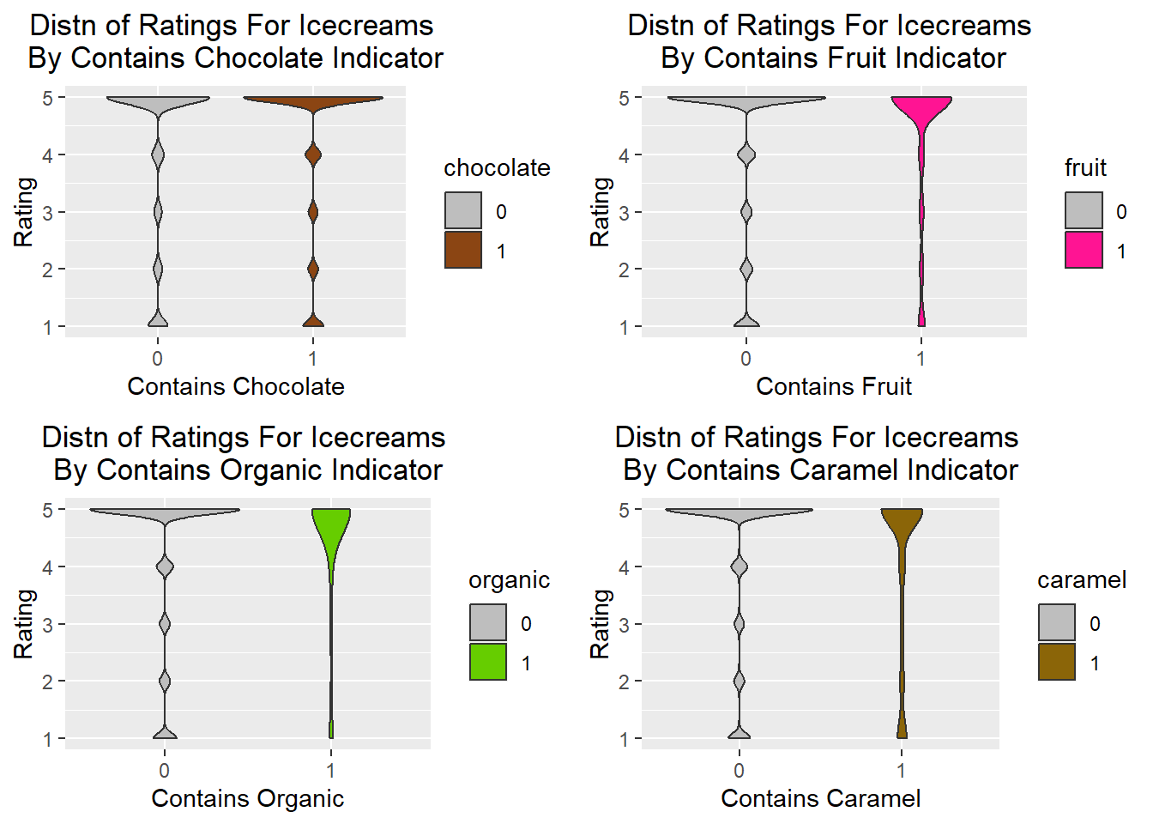
Hypothesis Testing - Ingredient Content
Here we see violin charts for prepared ingredient indicators.
These indicator variables were created using grepl
We see that the distributions for chocolate/non are similar, but there are differences in the others.

Slide 15
Hypothesis Testing - Chi Square Independence
HAS_CHOCOLATE - The Chi-Squared test yields a p-value of 6.49^{-6}, thus with 95% confidence we reject the null hypothesis that star rating is independent of chocolate ingredient content in the icecreams.
HAS_FRUIT - The Chi-Squared test yields a p-value of 1.122^{-4}, thus with 95% confidence we reject the null hypothesis that star rating is independent of fruit ingredient content in the icecreams.
HAS_ORGANIC - The Chi-Squared test yields a p-value of 0.192, thus with 95% confidence we fail to reject the null hypothesis that star rating is independent of organic ingredient content in the icecreams.
HAS_CARAMEL - The Chi-Squared test yields a p-value of 1.122^{-4}, thus with 95% confidence we reject the null hypothesis that star rating is independent of caramel ingredient content in the icecreams.

Slide 16
Exploratory Data Analysis: Takeaways
All of the datasets display a left-skewed distribution
Talenti has the highest average rating compared to the other brands
The flavor “Chocolate Chip Cookie Dough” has appeared twice for being the lowest rated flavor across all brands
Customers praise their favorite flavor, purchase multiple pints of the product when available, if the product is not available customers will be willing to travel afar to purchase it
Customers complain of lacking or non-existent toppings in products, flavors not meeting their expectations, and for flavors not being sold year-long

Slide 17
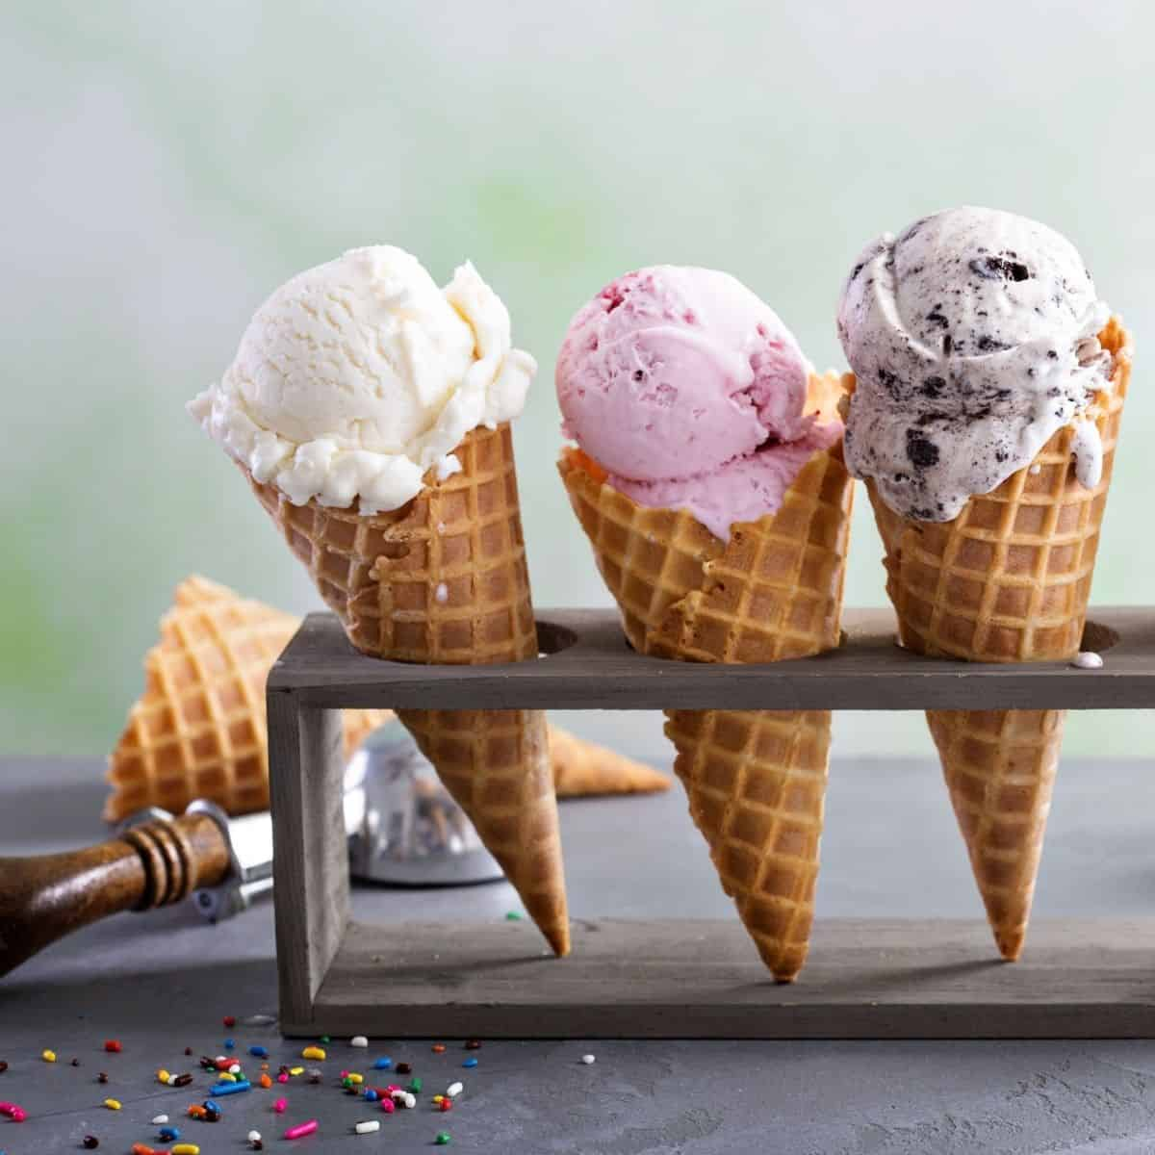
Analysis: Next Steps
Discriminant analysis would be an applicable method for predicting ratings for different factors (ingredient content, sentiment, etc)
Some time series EDA was conducted, anecdotally there appears to be correlation between time of year and icecream rating.
Both reviews and ingredients are text fields which offer opportunity for text mining or the parsing of unstructured string data for clustering and other analyses.

Slide 18
References
About Breyers History. (N.d.). Breyers. Retrieved March 12, 2024, from https://www.breyers.com/us/en/about.html
About Us. (N.d.). Häagen Dazs. Retrieved March 12, 2024, from https://www.icecream.com/us/en/brands/haagen-dazs/about
Our Process. (N.d.). Talenti. Retrieved March 12, 2024, from https://www.talentigelato.com/us/en/our-process.html
Our Values, Activism, and Mission. (N.d.). Ben & Jerry’s. Retrieved March 12, 2024, from https://www.benjerry.com/values
Pond, T. (2020, Sept). Ice Cream Dataset. Kaggle. Retrieved March 11, 2024, from https://www.kaggle.com/datasets/tysonpo/ice-cream-dataset/data

